Slide 1
WEDNESDAY, OCTOBER 19︎ ■ 3:00–4:00 P.M. (ET)

Slide 2
Speakers
Ken Fang
Associate General Counsel
Investment Company Institute
Katy Gordon
Associate General Counsel
Raymond James
Lance King
Counsel
Seward & Kissel

Slide 3
Polling Question 1
I attend law school in which of the following states/regions:
DC/Maryland/Virginia
Florida
Louisiana
New England
New York/New Jersey
Texas
Other

Slide 4
Polling Question 2
What year are you in law school?
2023
2024
2025
Other

Slide 5
Polling Question 3
Have you ever taken a securities class?
Yes
No

Slide 6
Agenda
Introduction to ICI and the asset management industry
Legal and compliance career opportunities
A day in the life as an asset management lawyer
Questions

Slide 7
ICI and Its Mission
ICI is the leading association representing regulated investment funds. Its mission is to strengthen the foundation of the asset management industry for the ultimate benefit of the long-term individual investor.

Slide 8
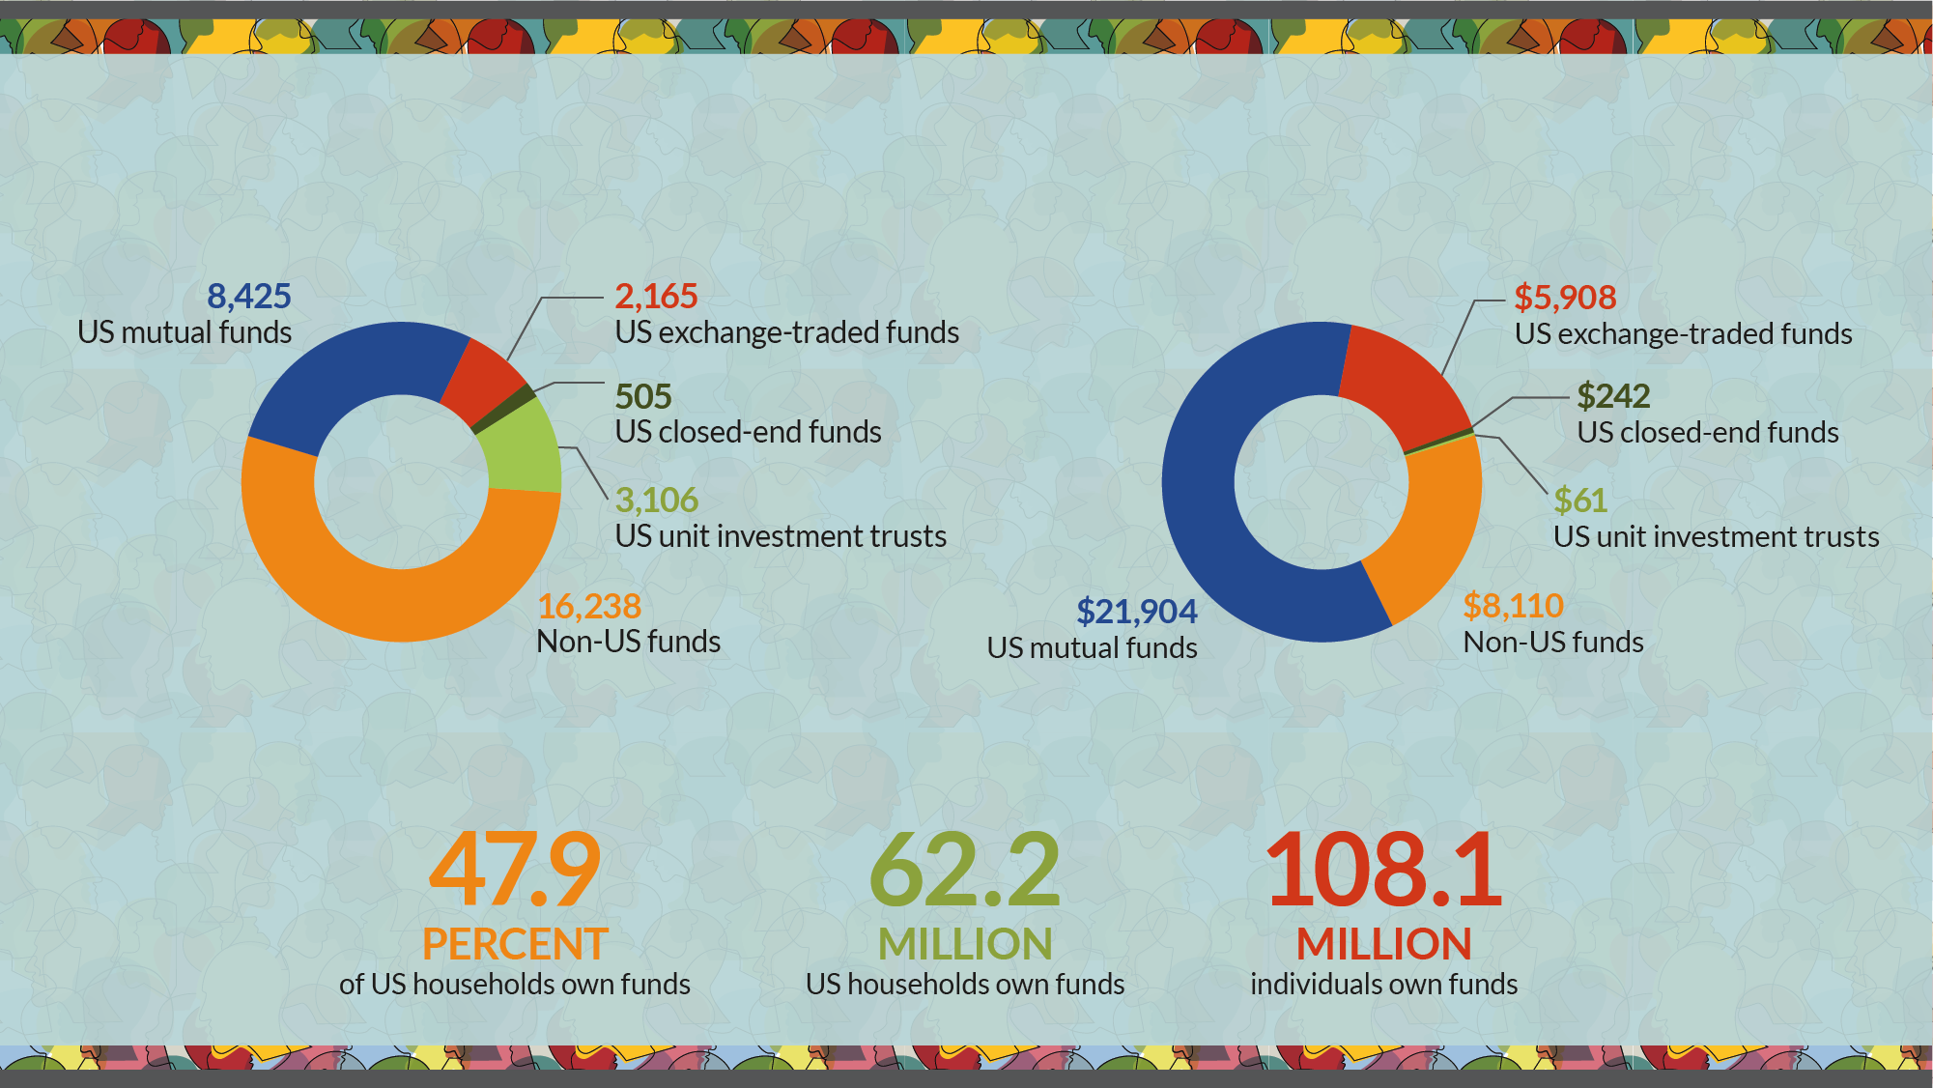
ICI Membership at a Glance
More Than 30,000 Funds
Number of investment companies by type*
With $36.2 Trillion in Assets
Investment company assets, billions of dollars*
Serving more than 100 million shareholders
US ownership of funds offered by investment companies*
* Data for ownership of funds are as of mid-2022.

Slide 9
Asset Management 101
What is the asset management industry?
Who (or what) are asset managers?
Who (or what) are their clients?

Slide 10
Asset Managers
Invest client money, acting as fiduciary, for a fee
  This allows clients to obtain professionally managed and diversified portfolios at a reasonable cost
Regulated as an “Investment Adviser”
  An asset manager is different from a bank, insurance company, or broker-dealer
  While some are stand-alone asset managers, many are affiliated with other types of financial services firms
Use a variety of vehicles to serve clients
    Mutual Funds
    ETFs
Hedge Funds
  Separately Managed Accounts
Common Trusts

Slide 11
Mutual Fund Regulations
Subject to four major federal securities laws
    Securities Act of 1933
    Securities Exchange Act of 1934
    Investment Advisers Act of 1940
    Investment Company Act of 1940
Sound, strong regulation is critical to industry success!

Slide 12
Asset Management Clients
Individuals
Corporations and Banks
Retirement Plans and Trusts
Governments
Foundations and Endowments
Charities
Insurance Companies

Slide 13
Legal Careers in Asset Management
asset managers Require support from Many Types of Lawyers and Compliance Professionals
Regulatory Specialists
  Investment Company Act
  Investment Advisers Act
  ERISA
  International Regulation
Legal Generalists
  Litigators
  Commercial/Contractual
  Corporate Governance/Securities
  Intellectual Property
  Employment/Employee Benefits
  Data Privacy
Compliance Professionals
  Investments
  Trading
  Advertising/Client Communications
  Licensing/Regulatory Filings
  Ethics/Training
Investments
Trading
Legal
&
Compliance
Corporate
Distribution
IT/Cyber Security
Operations/Support

Slide 14
Where do Asset Management Lawyers Work?
As in-house counsel, at asset management firms, corporations, or other businesses with significant investment portfolios
At a company that helps to support asset managers, like consulting firms, accounting or auditing firms, or other vendors
At law firms, as outside counsel
In government, at federal regulators like the Securities & Exchange Commission (SEC) or similar state regulators
In policy circles, at trade associations, think tanks, or similar advocacy organizations
In academia, at law schools or undergraduate institutions

Slide 15
QUESTIONS?

Slide 16
Upload Your Resume
Webinar registrants are invited to upload their resumes to ICI’s Talent Connection Resumé Database.
ICI member firms will have access to the resumés and may contact participants directly regarding internship and job possibilities.

Slide 17


